Slide 1
DESIGN OF AN INDOOR AUTONOMOUS MOBILE ROBOT BASED ON ROS
Speaker: Hoàng Văn Tiến

Slide 2

Content
System Design Process
Technical Requirements Definition
Hardware System Design
Software System Design
System Testing

Slide 3
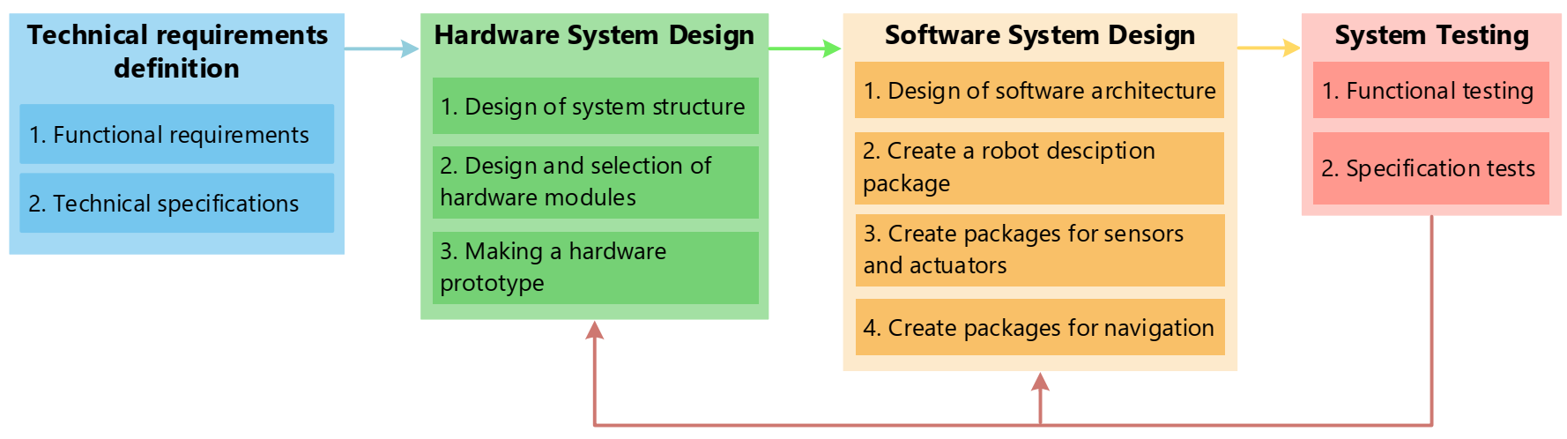
System Design Process

Slide 4
Technical Requirements Definition
Functional requirements
Self-localization
Mapping
Navigation
Obstacle avoidance
Technical specifications
Mass
Dimensions
Loads
Velocities

Slide 5
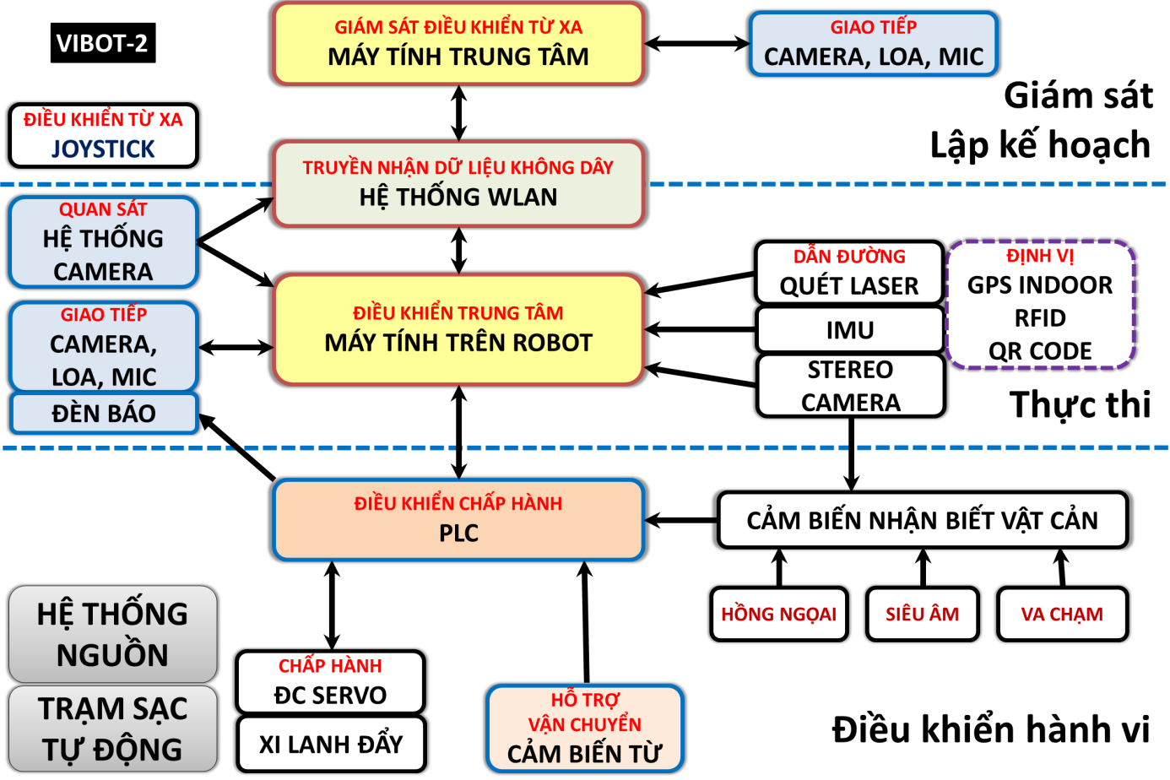
Hardware System Design
Design of system structure
Based on technical requirements

Slide 6
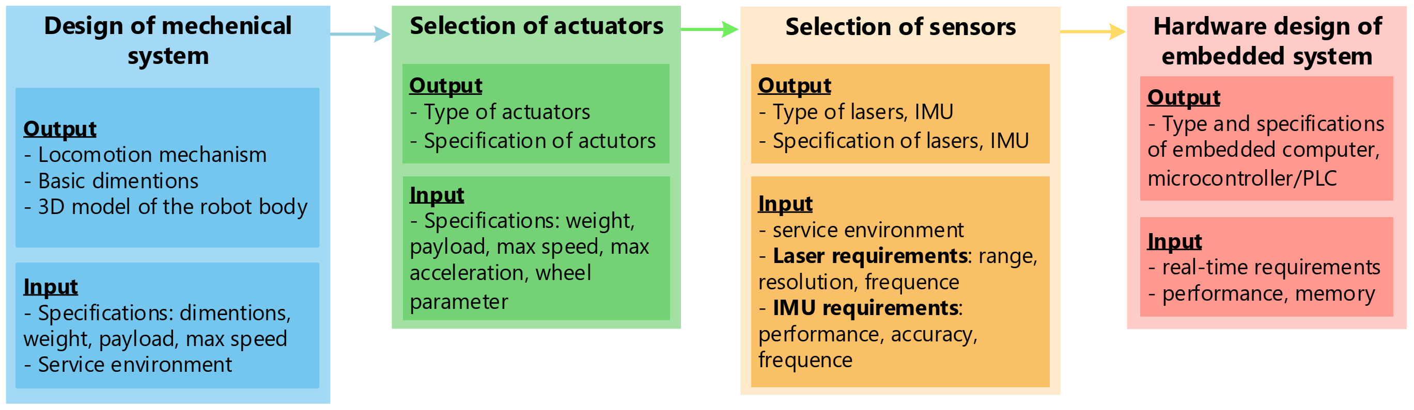
Hardware System Design
Design and selection of hardware modules

Slide 7
Hardware System Design
Making a hardware prototype
Manufacturing mechanical details
Assemble mechanical details
Integrating sensors, actuators and the hardware of embedded system into mechanical system
Take mechanical tests

Slide 8
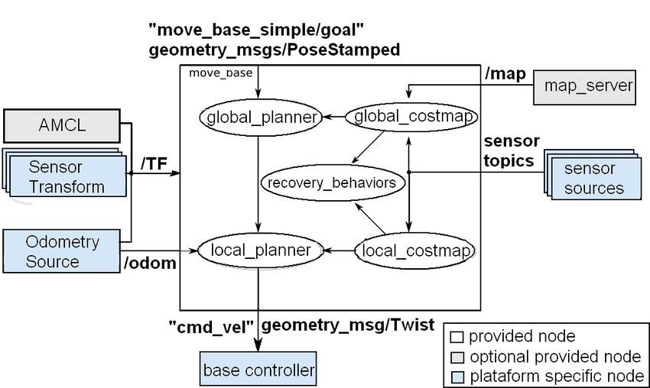
Software System Design
Design of software architecture

Slide 9
Software System Design
Design of software architecture
Package “robot_description ”: provide the robot model
Package “robot_control”: provide the base controller
Packages for getting data from sensors: encoder, laser, IMU
Package “robot_localization”:fuses data from IMU, encoder and creates resulted odometry
Navigation packages for self-localization, mapping, motion planning

Slide 10
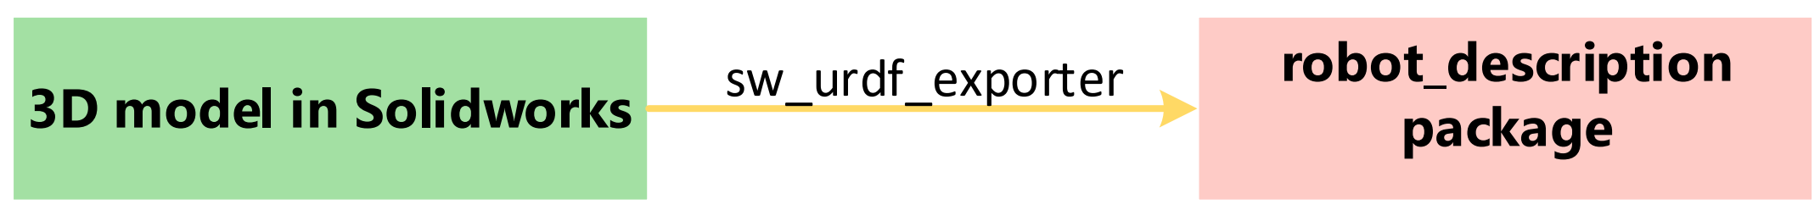
Software System Design
Create the “robot_description”

Slide 11
Software System Design
Create packages for sensors and actuators
Find suitable packages for the given sensors
http://wiki.ros.org/Sensors
Create the package for controlling base motion
Create the package for wheel odometry

Slide 12
Software System Design
Create packages for robot navigation
Install the Navigation Stack
Packages for global planner:
global_planner
Navfn
carrot_planner
Packages for local planner:
base_local_planner
dwa_local_planner
eband_local_planner
teb_local_planner
mpc_local_planner

Slide 13
Software System Design
Create packages for robot navigation
Configure the Navigation Stack
Costmap Configuration (local_costmap) & (global_costmap)
Global Planner Configuration
Local Planner Configuration
AMCL Configuration (Adaptive Monte Carlo Localization (AMCL))
Creating a Launch File for the Navigation Stack
For running AMCL
For mapping
For motion planning
Running the Navigation Stack

Slide 14
System Testing
Functional testing
Self-localization
Mapping
Motion planning
Obstacle avoidance
Specification tests
Loading
Max speed
Run time

